Slide 1


COSC 4P02 – MOBI Chatbot
Front End: Eric Kohler, Nathalie Atouba-Eyoune, Zihao Zhao
Back End: Brandon D. Wanji, Kenny Yang, Alex, Santiago, Jiahui xu

Slide 2





Demo

Slide 3

Deciding on website content and layout
1 FAQ section
1 chatbot window,
1 page website with links to external sources.
Notes:
Keep our style consistent with Brock

Slide 4
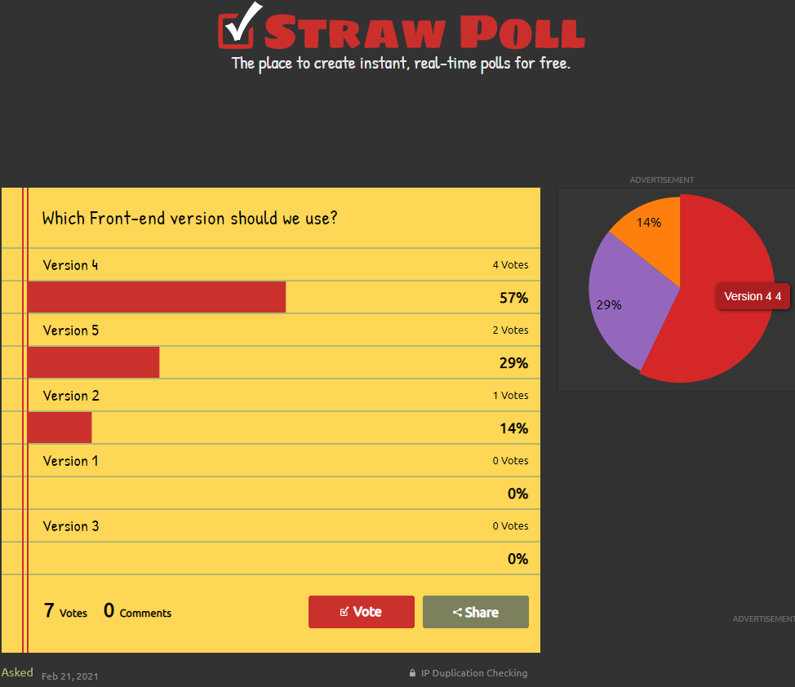

Slide 5
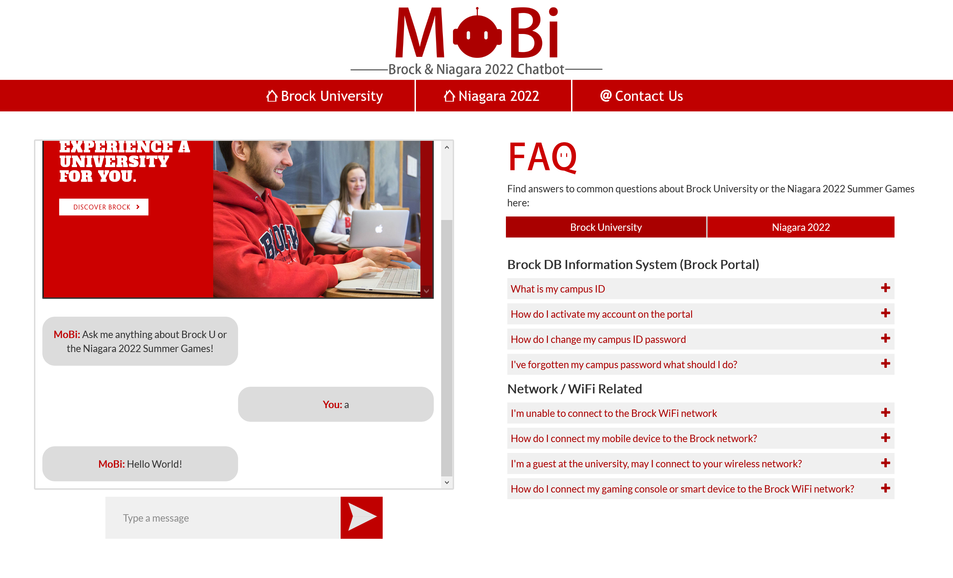
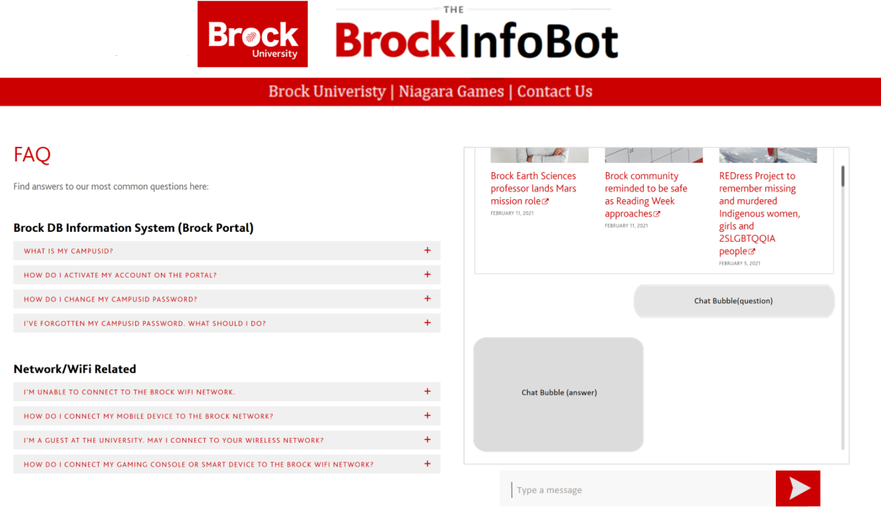
Refining the design
Notes:
Keep our style consistent with Brock

Slide 6

UI Design
Notes:
Zihao

Slide 7
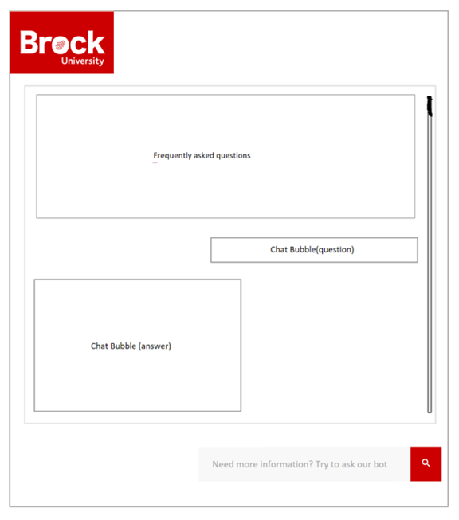
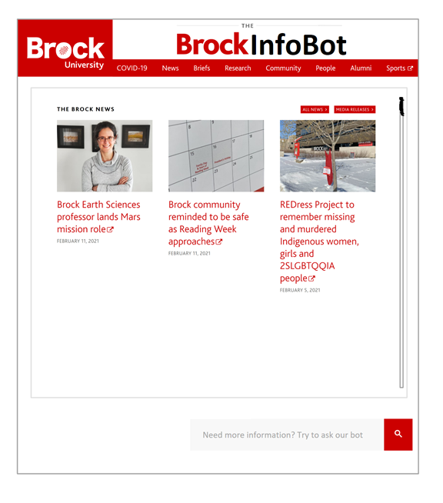
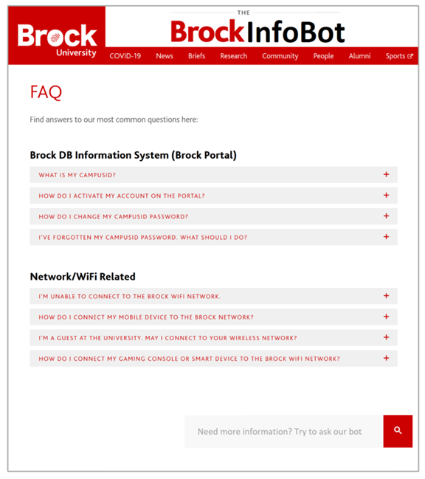
Website structure
Notes:
Zihao

Slide 8
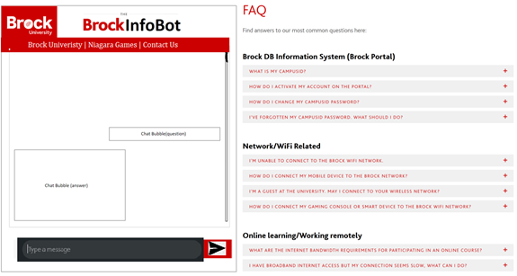
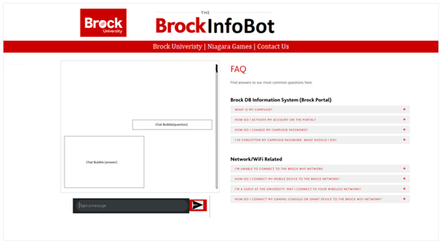
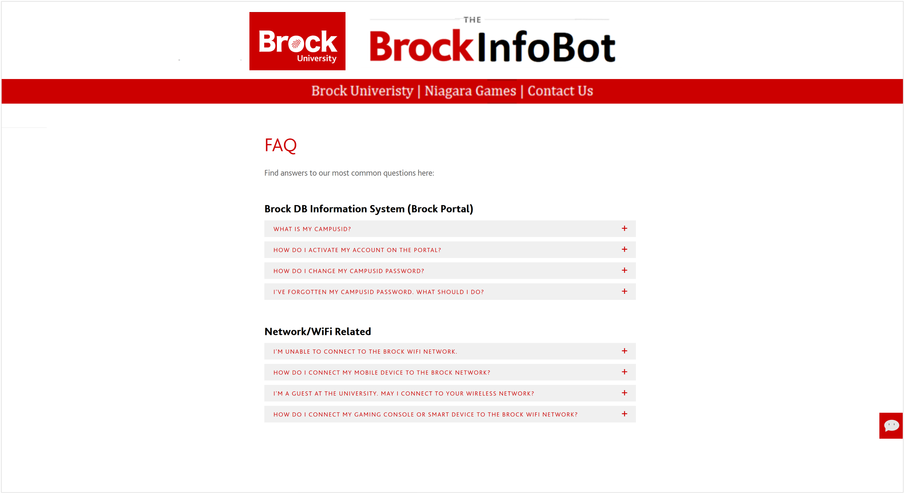
Webpage structure
Notes:
Zihao

Slide 9
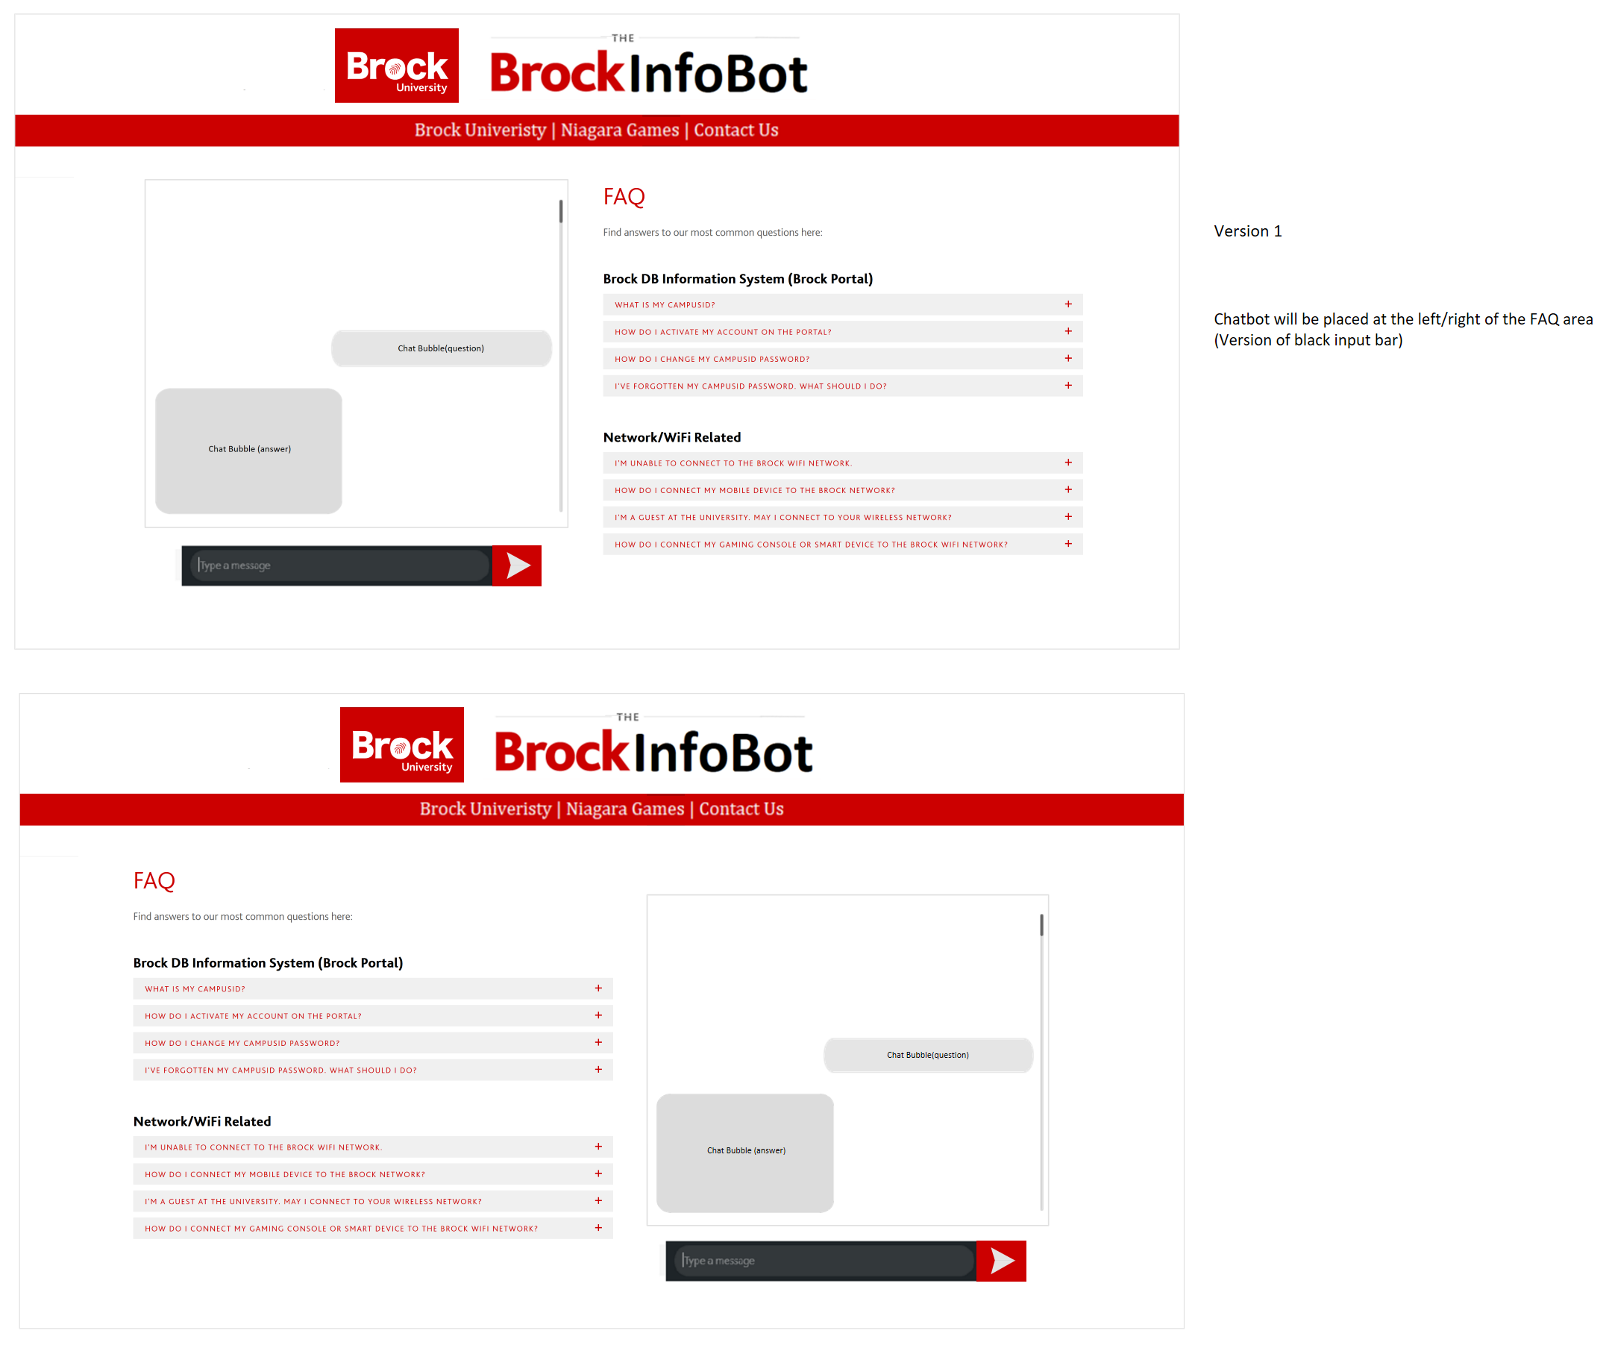
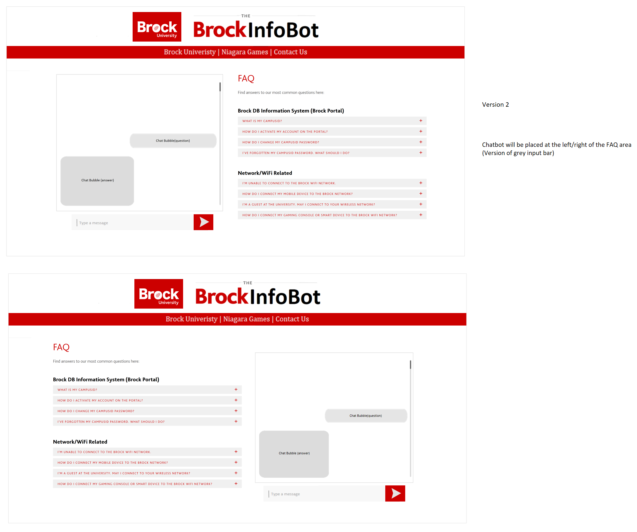
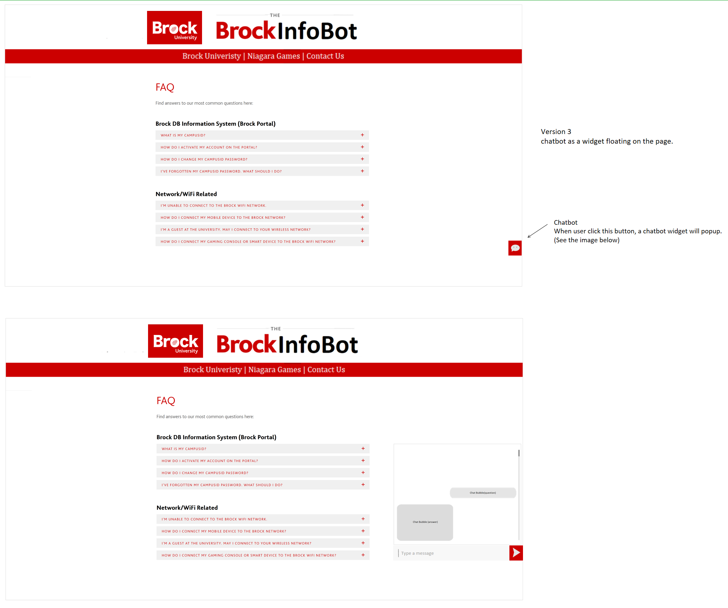
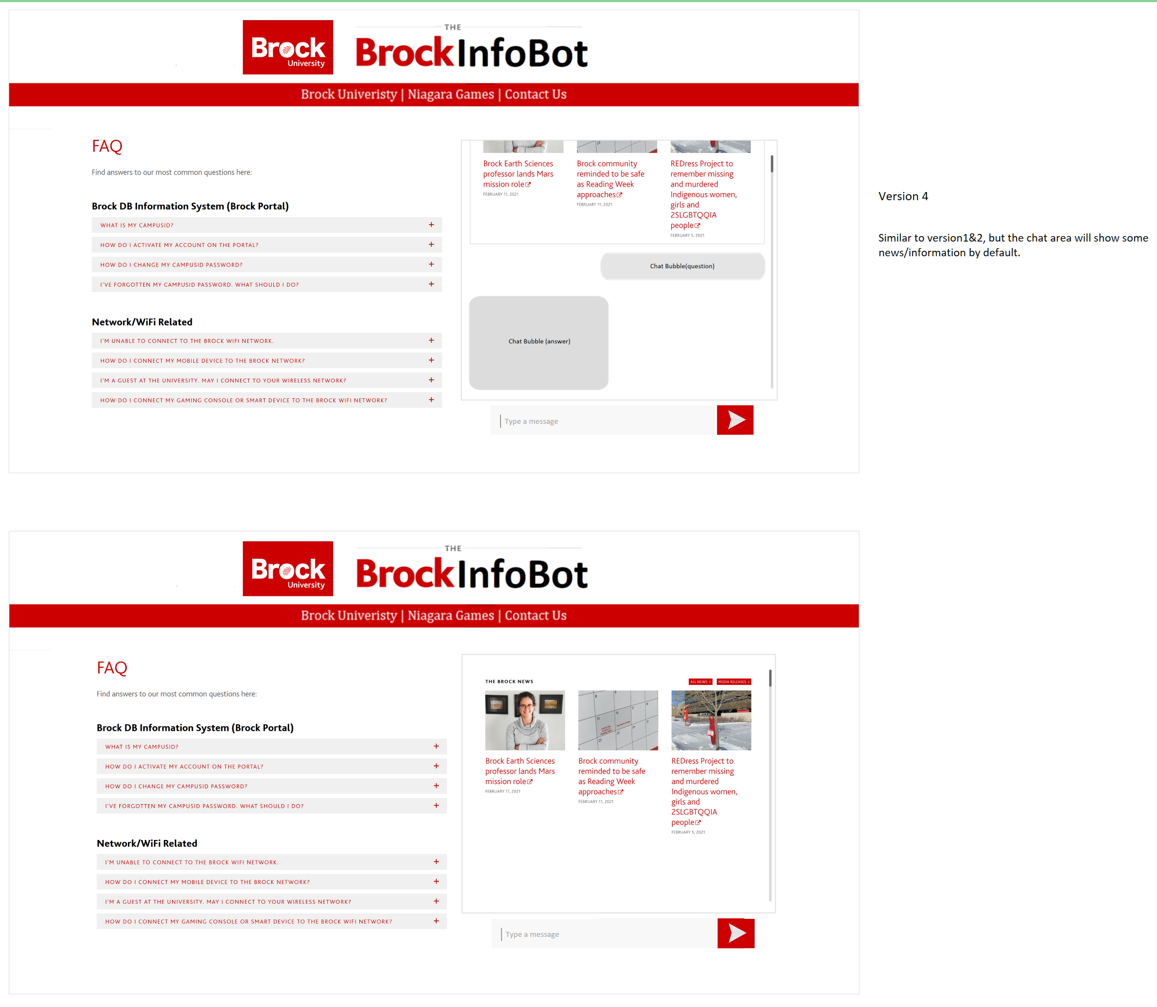
Voting the final style
Notes:
Zihao

Slide 10

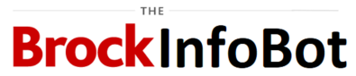
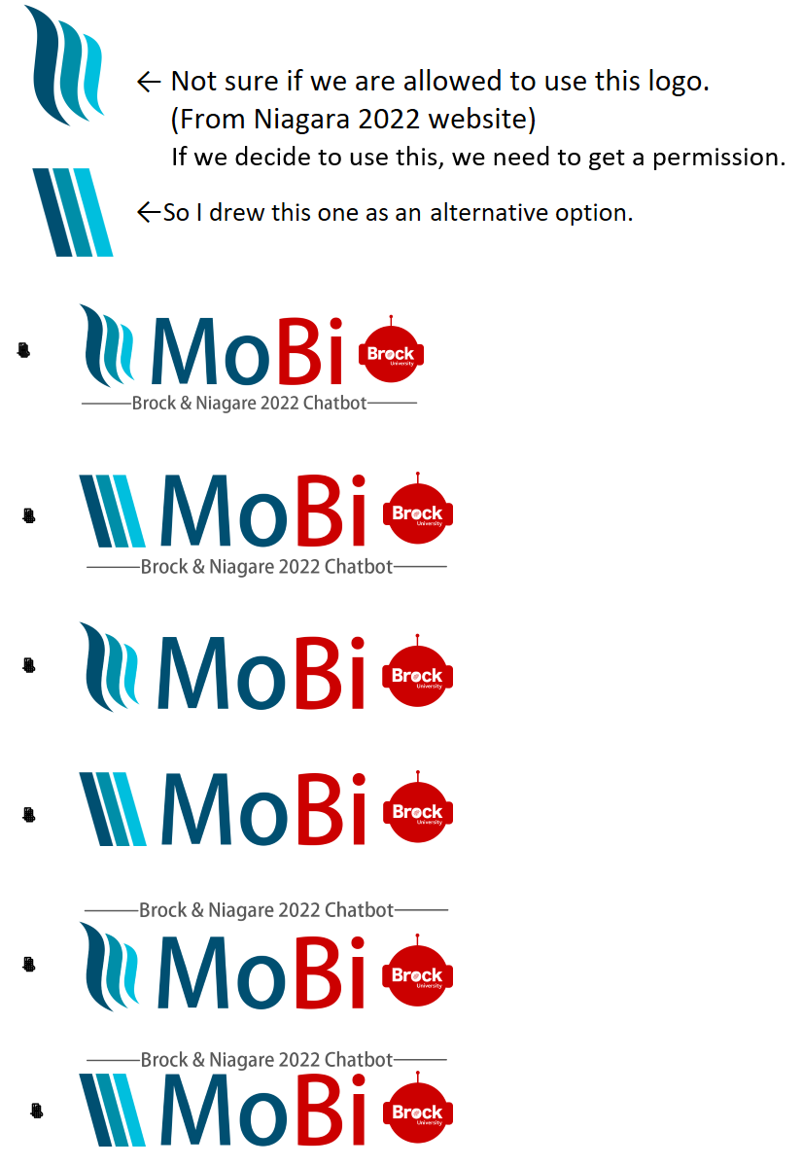
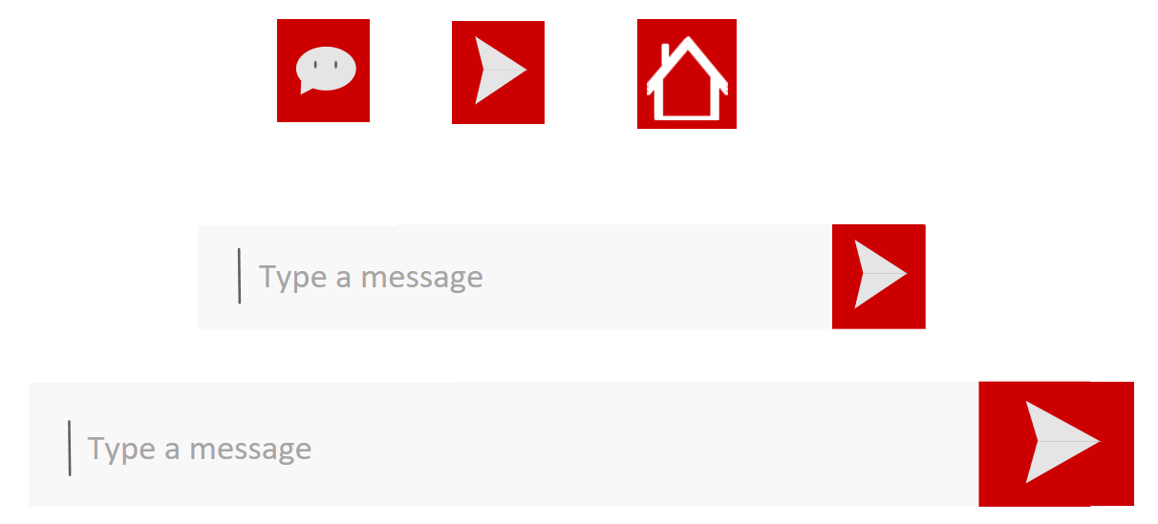
Logo Design
Notes:
Zihao

Slide 11
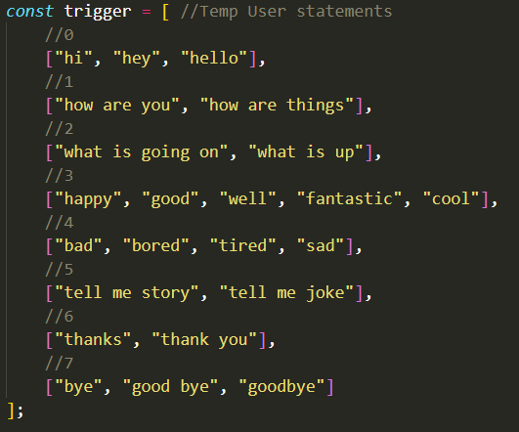
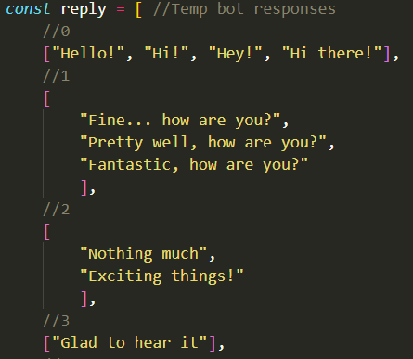
Implementing the Front End Chatbot

Slide 12
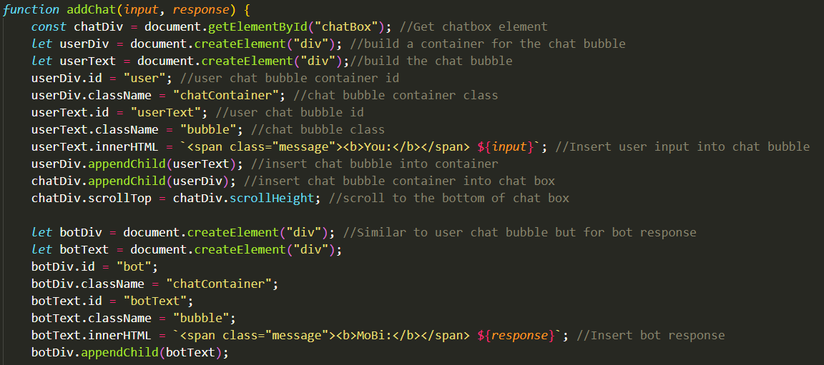
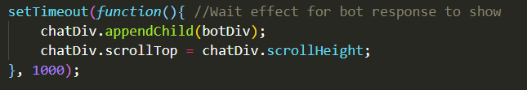
Implementing the Front End Chatbot

Slide 13
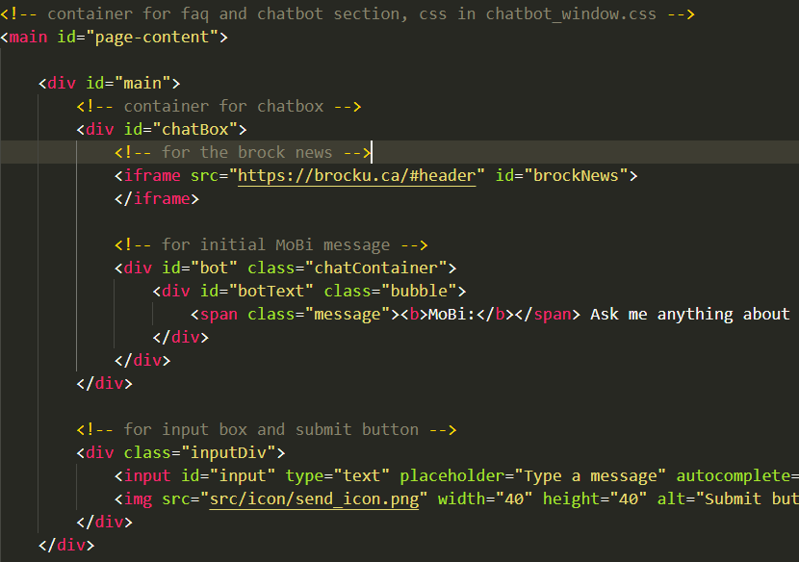
Implementing the Front End Chatbot

Slide 14
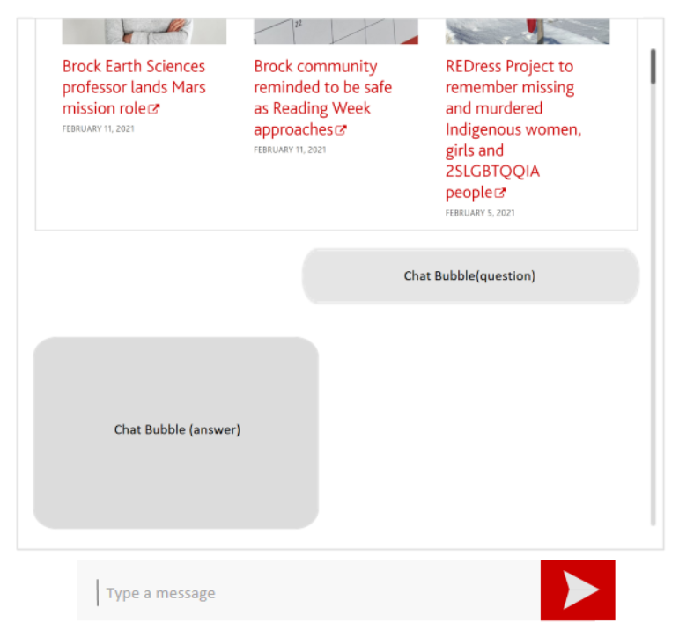
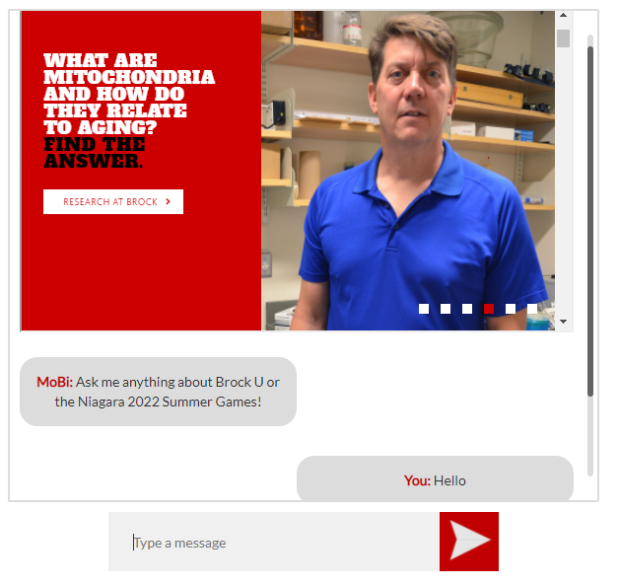
Implementing the Front End Chatbot
Original Design
Front End Version

Slide 15
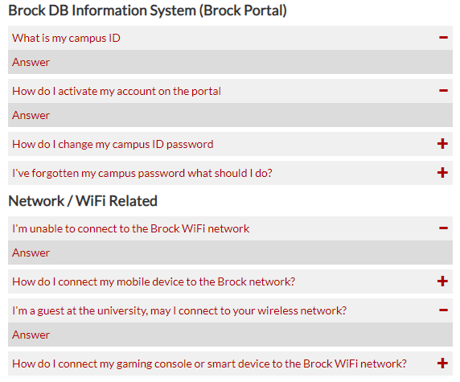
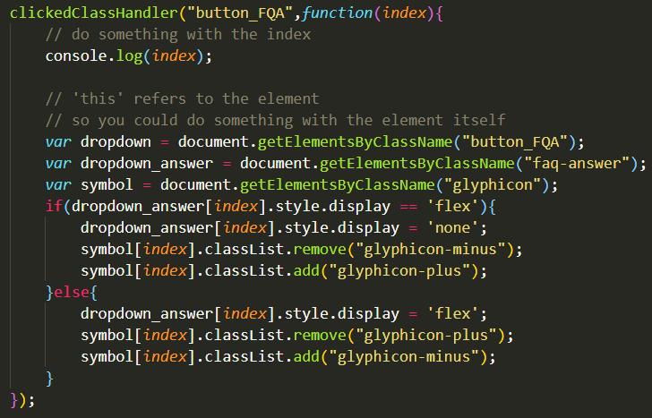
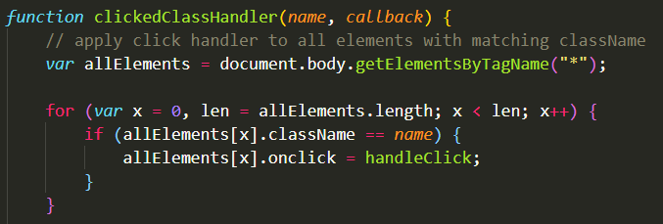
Adding Functionality to the FAQ

Slide 16
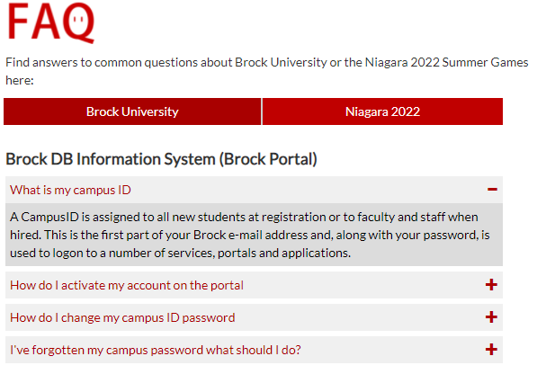
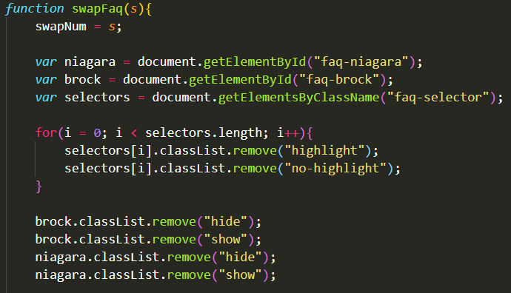
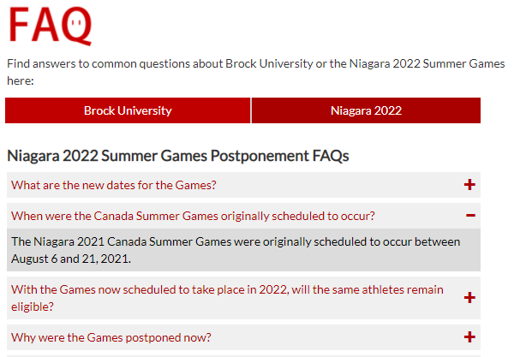
Adding Functionality to the FAQ

Slide 17
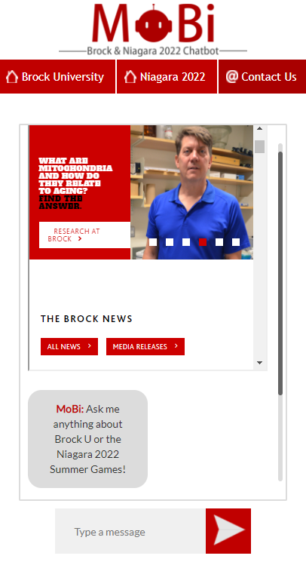
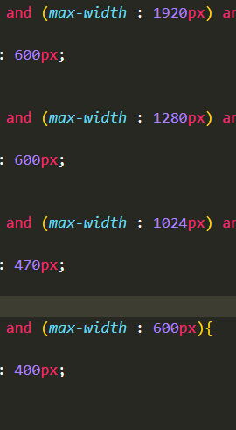
Adding Responsive Web Design

Slide 18
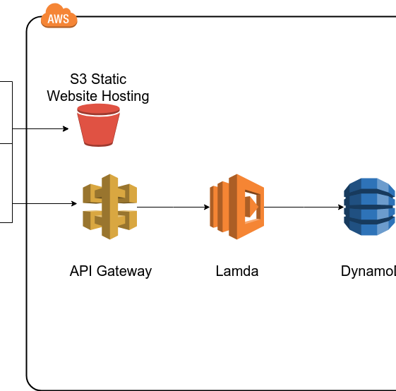
Hosting on AWS
Notes:
Keep our style consistent with Brock

Slide 19
Mobi Learning
Input
Pre-processing
Machine Learning
Neural Network
Result

Slide 20
Scraping & Translating to JSON
Picking webpages to scrape
Looking at the webpage tags
Grouping webpages
Scrape webpages
Convert scraped data to JSON
Fix formatting of scraped data

Slide 21
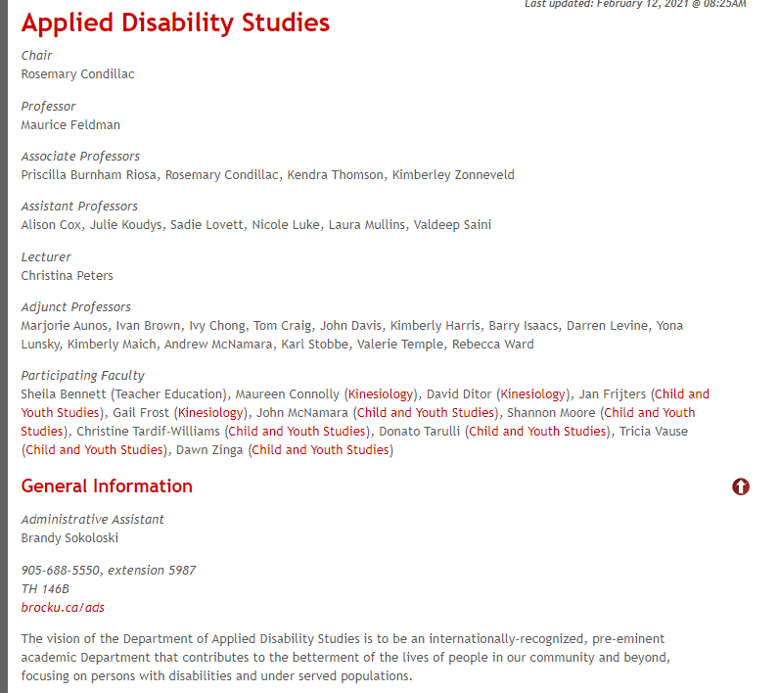
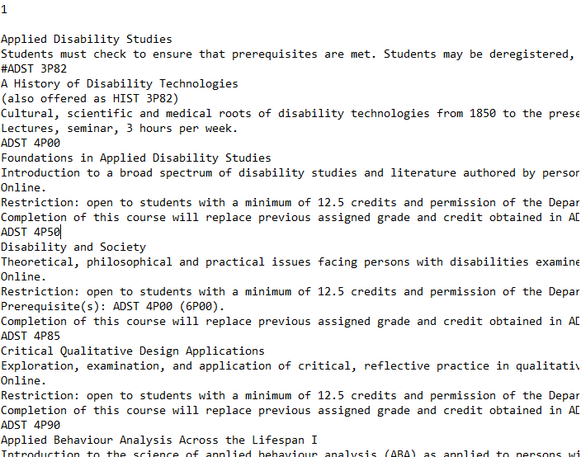
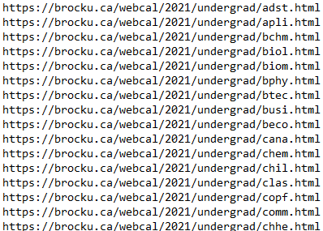
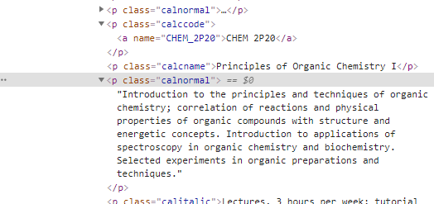
Brock University Scraper 1

Slide 22
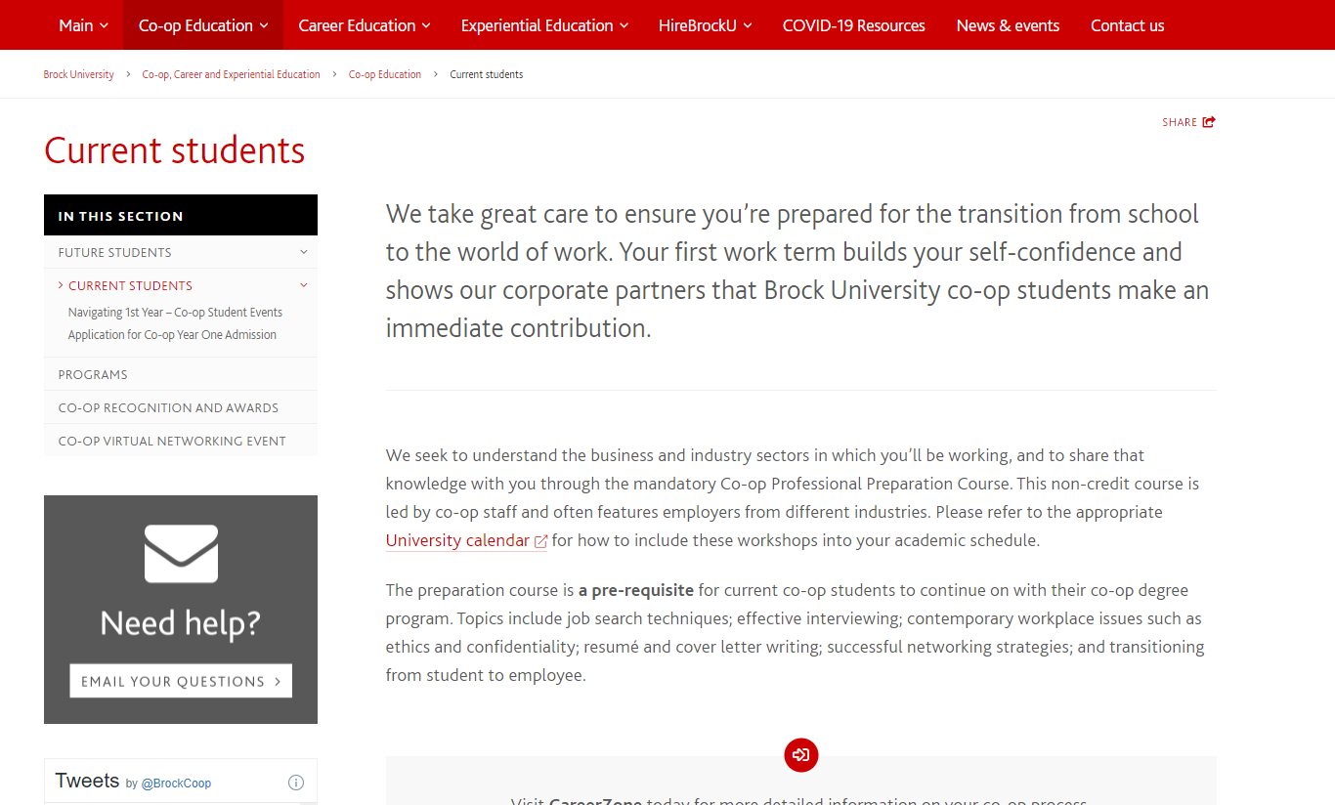
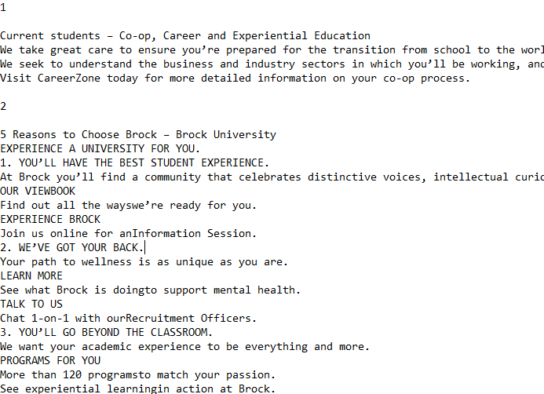
Brock University Scraper 2

Slide 23
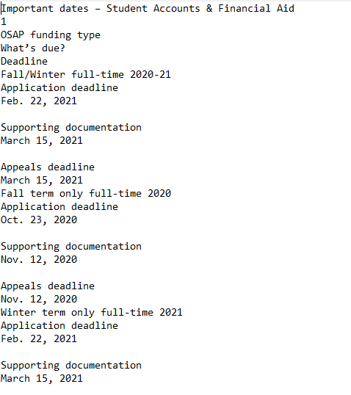
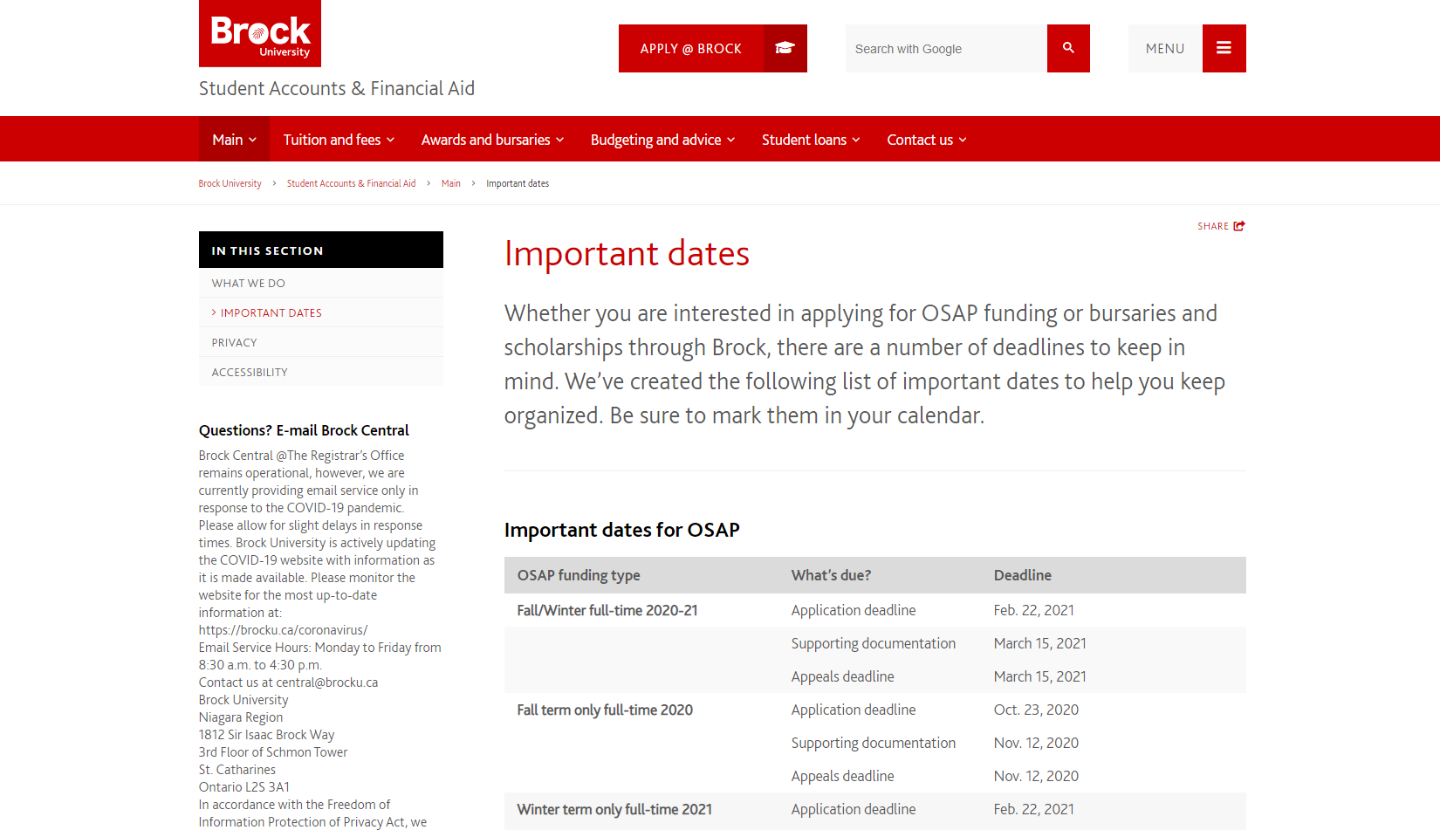
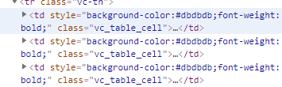
Brock University Scraper 3

Slide 24
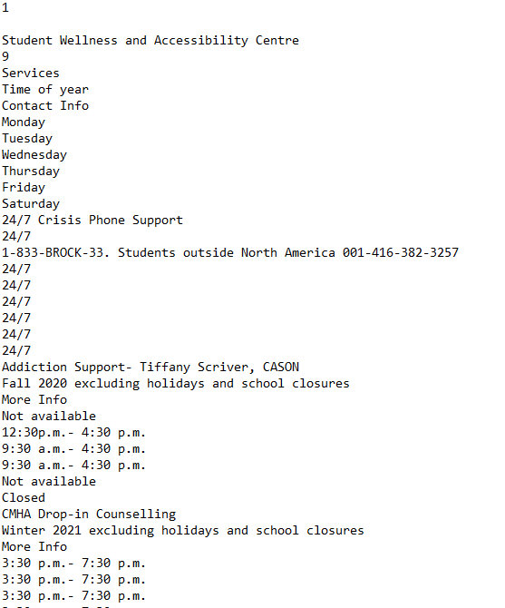
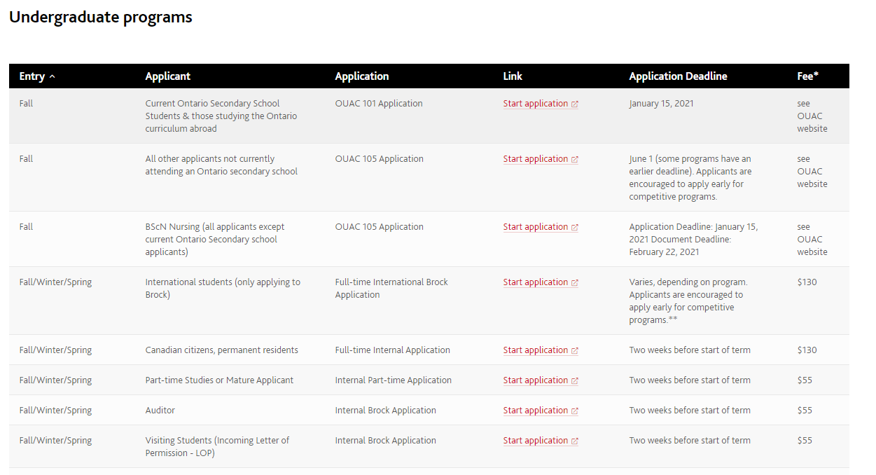
Brock University Scraper 4

Slide 25
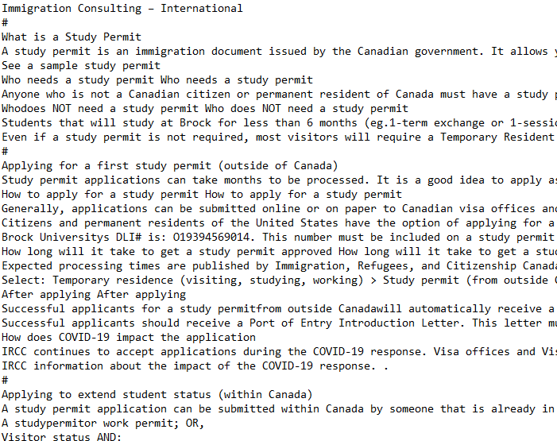
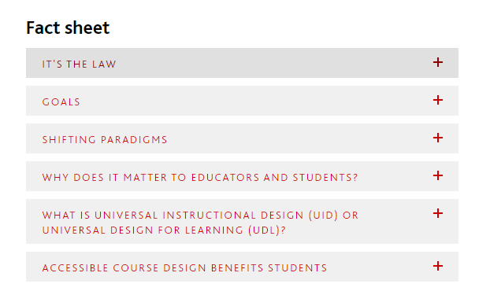
Brock University Scraper 5

Slide 26
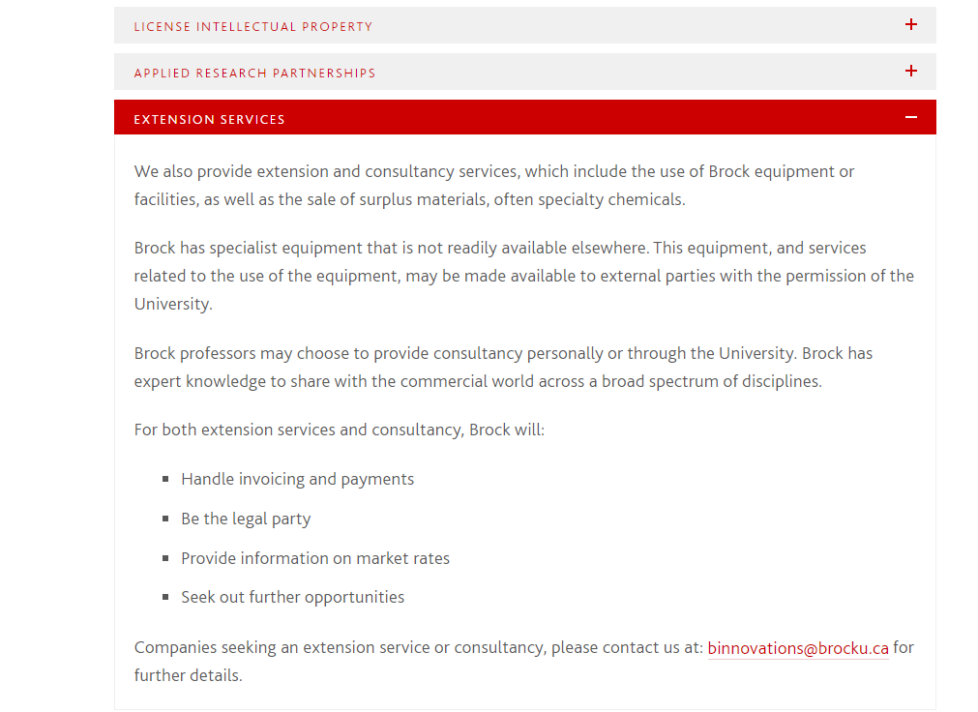
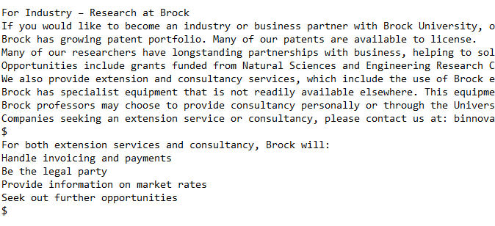
Brock University Scraper 6

Slide 27
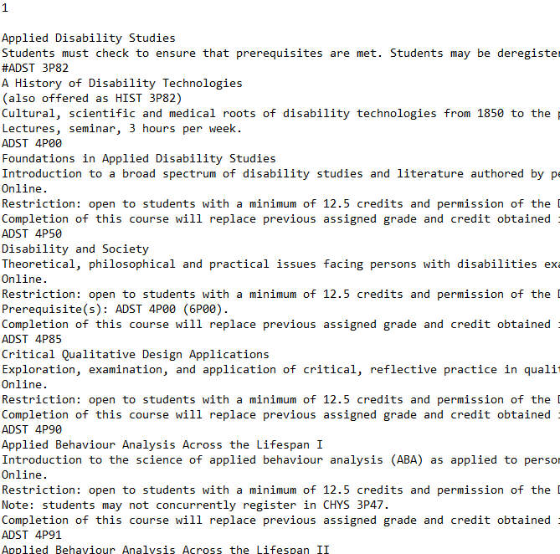
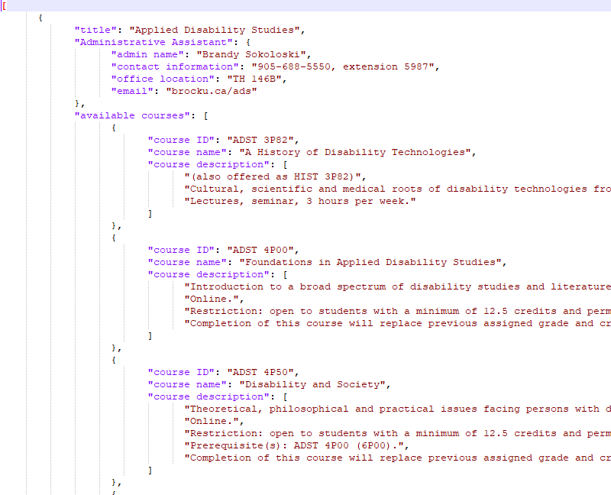
Converting to .JSON

Slide 28
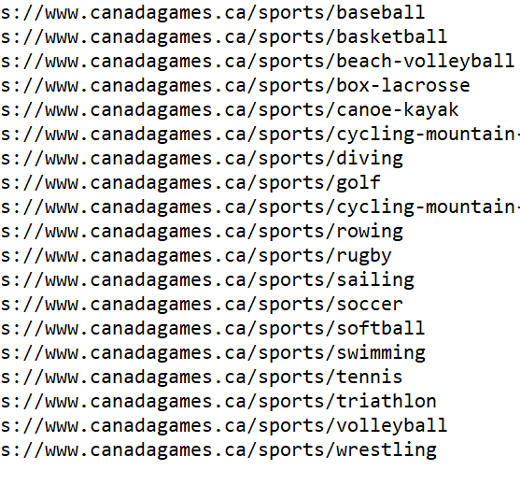

Niagara Sports Scraper

Slide 29


Scraping Process

Slide 30


Taglines

Slide 31
Setting Up Sport Data Structures

Slide 32

Each separate sport was a dictionary in an overlying sports list
Table data was also separated into another dictionary containing the title and headers and each rows data in a list for ease of access.
Table1.row1.firstitem

Slide 33


Each Sport had Three Notable Alumni
The Alumni are grouped as a list of dictionaries
Each dictionary contains the Alumni name and profile link

Slide 34

Formatting and Writing to JSON

Slide 35

Scraping Challenges and Solutions

Slide 36
Uniformity of Webpage Structure
Brock Universities web pages sometimes even if within the same directory have different structures of their site
For example, page titles were not in the same location or under the same class name making universal scrapers sometimes not possible
Separate functions and methods were created to act as scrapers for the pages that did not conform to certain pattern or structure

Slide 37
Text Encoding Issue and Solution
Scraped data from the web pages were encoded using Unicode UTF-8 causing unwanted text and newline characters
Encoding in a separate format would still cause a different variety of characters to appear, therefore, encoding and decoding was necessary
Text was encoded as ASCII and then decoded as UTF-8 to make it readable and then remove any starting and ending characters that were now being shown

Slide 38

Direct Link Scraping

Slide 39



Output of the direct link Scrape
We collected 13 websites from Brocku.ca and niagara2022games.ca to be scraped as direct link.

Slide 40

Testing and error handling

Slide 41



Expected result content
Weblink list
Console output

Slide 42
Future improvement
Chatbot AI enhancement
Amazon Lex(voice & text)

Slide 43
Chatbot AI enhancement
Truly conversational
Deal with complex sentences
Remove ambiguity

Slide 44


Slide 45


Slide 46
Amazon Lex(voice & text)
Voice to text
More comfortable use voice
Increase reliability

